Slide 1
Relational algebra

Slide 2
Objectives
How to form queries in relational algebra

Slide 3
Introduction
Similar to normal algebra (as in 2+3*x-y), except we use relations as values instead of numbers, and the operations and operators are different.
Not used as a query language in actual DBMSs. (SQL instead.)
The inner, lower-level operations of a relational DBMS are, or are similar to, relational algebra operations. We need to know about relational algebra to understand query execution and optimization in a relational DBMS.
Some advanced SQL queries requires explicit relational algebra operations, most commonly outer join.

Slide 4
Relations are seen as sets of tuples, which means that no duplicates are allowed. SQL behaves differently in some cases. Remember the SQL keyword distinct.
SQL is declarative, which means that you tell the DBMS what you want, but not how it is to be calculated. A C++ or Java program is procedural, which means that you have to state, step by step, exactly how the result should be calculated. Relational algebra is (more) procedural than SQL. (Actually, relational algebra is mathematical expressions.)

Slide 5
Relational Algebra
Relational algebra is high level procedural language
Relational algebra operations work on one or more relations to define another relation with out changing original relations
Both operands and results are relations
Output from one relation can be input to another
Allows nested expressions
Closure property

Slide 6
Review of concepts and operations from set theory
set
element
no duplicate elements (but: multiset = bag)
no order among the elements (but: ordered set)
subset
proper subset (with fewer elements)
superset
union
intersection
set difference
cartesian product

Slide 7
Relational Algebra
Basic operations
Selection, Projection, Union, Set difference, Cartesian product and Rename
Perform most required data retrieval operations
Additional operations
join, set intersection, Division and assignment
Can be expressed in terms of the basic operations.

Slide 8
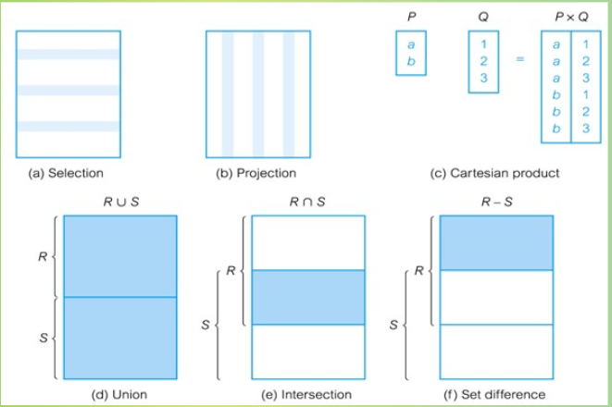

Slide 9
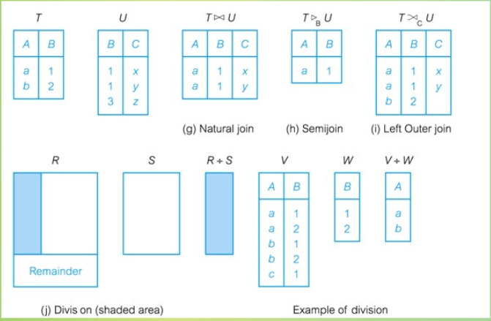

Slide 10
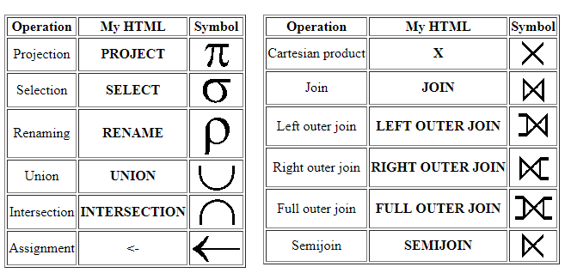

Slide 11
Basic Operations
Unary operators: operate on one relation
Selection, Projection, Rename
Binary operators: operate on pairs of relations
Union, Set Difference, Cartesian product
The result of an operation is a new relation.

Slide 12
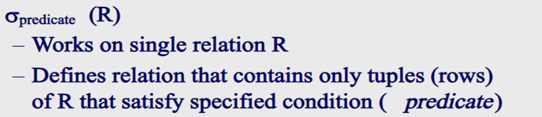
Selection(or Restriction)
We use the Greek letter sigma (σ) for the operator.
The predicate has a comparison operator (>, <, =, ≠ (not equal), ≥, ≤ ).
You can compare values in different attributes or compare an attribute to a constant value.
It can also include logical AND, OR and NOT operators: ∧, ∨, ¬.

Slide 13

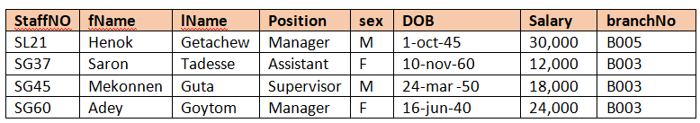
Example –Selection(or restriction)

Slide 14
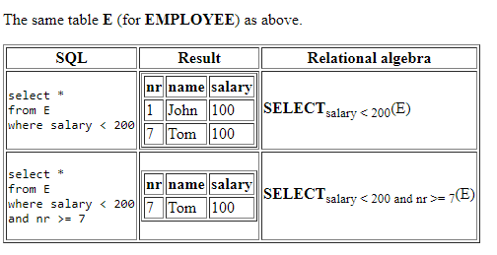

Slide 15
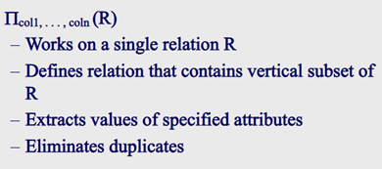
Projection
We use the greek letter Pi for the operand (Π)

Slide 16

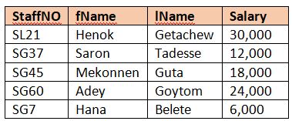
Example- Projection

Slide 17
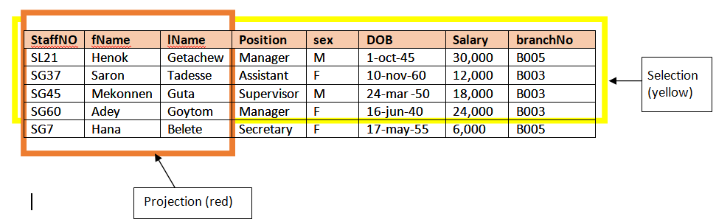

Slide 18
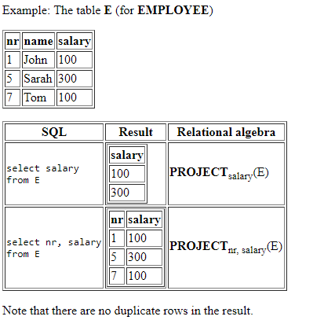

Slide 19
How selection and projection are used in SQL ?
Select *
From Staff
Where Salary >10,000;
What part is equivalent to a relational algebra select operation – can you see an argument relation and a predicate?
What part is equivalent to the project operation?
SELECT staffNO, fName,lName,Salary
From Staff;

Slide 20


Union
When doing a union operation:
Must use compatible relations – it must make sense to union the 2 relations. For example, it does not make sense to union the student and course relations.
The relations being union-ed must have the same number of attributes – we say that the relations have the same arity.
The domains of the corresponding attributes must be the same. In other words: for r ∪ s, the domain of the i^{th} attribute of r must be the same domain as that for the i^{th} attribute of s.

Slide 21
Exercise- Union
list of all student and teacher names, along with their email addresses
Teacher-Schema (teacherid, teacher_firstname, teacher_fathersname, teacher_email)
Student-schema = (student_id, student_firstname, student_fathersname, programme_code, student_email)
Πstudent_firstname, student_fathersname, student_email (student)
∪
Πteacher_firstname, teacher_fathersname, teacher_email (teacher)

Slide 22
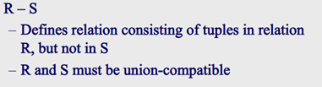
Set-Difference

Slide 23
Example-Set difference
find students who are taking the ICT252 course but who are not taking the ICT231 course ?

Slide 24
get a relation showing students taking ICT252 – just get the student ID
Π_{student_id} (σ_{course_code=”ICT252”} (studentCourse))
get a relation showing students taking ICT231 – should be compatible with the first relation:
Π_{student_id} (σ_{course_code=”ICT231”} (studentCourse))
Now we can get the difference between these two:
Π_{student_id} (σ_{course_code=”ICT252”} (studentCourse)) –
Π_{student_id} (σ_{course_code=”ICT231”} (studentCourse))

Slide 25
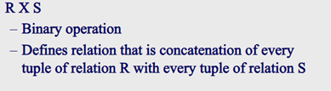
Cartesian Product
The result is a relation that has all the attributes from both relations and whose tuples are all the possible combinations of the tuples from each of the 2 relations.
so if we have n tuples in R and m tuples in S, r(RxS) contains (n x m) tuples.

Slide 26
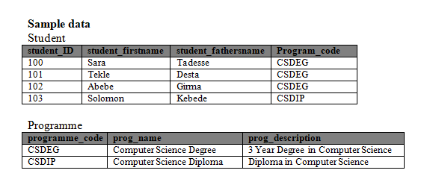

Slide 27
Example-Cartesian Product
r=Student X Programme
The attributes in r are:
(student.stud_id, student.stud_firstname, student.stud_fathersname, student.prog_code, programme.prog_code, programme.prog_name, programme.prog_desc)

Slide 28
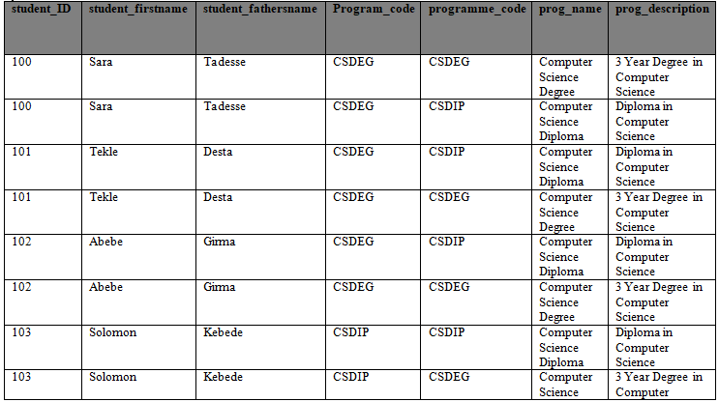

Slide 29
Example-on Cartesian product, selection and projection
Get name of all students on the Computer Science Degree programme ?

Slide 30
R= Πstud_firstname,stud_fathersname (σstudent.prog_code=programme.prog_code (
σprog_name=”Computer Science Degree” (student x programme)
))
Cartesian product and selection can be used to reduced to single operation join

Slide 31
Write an expression to get a list of all students taking the course ICT252 – the list should show each student’s full name.

Slide 32
R = Πstud_firstname,stud_fathersname (σstudent.stud_id=studentCourse.stud_id (
σ_{course_code=”ICT252”} (student x studentCourse)
))

Slide 33
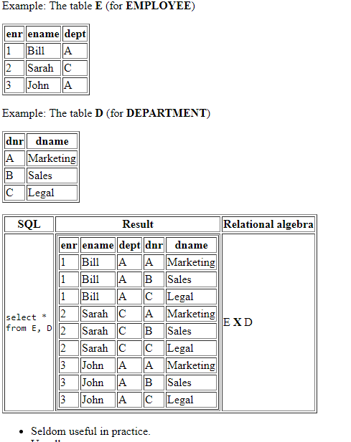

Slide 34
Rename
ρ_{x}(E)
To rename the relation given by an expression E to the name x:

Slide 35
Example- Rename
ρ_{csdeg_students} (σ_{programme_code=”CSDEG”} (student))
The operation returns the relation given by the expression, and the relation is named csdeg_students. Can now use that name in further operations.
To find any students named Solomon who are on the CSDEG programme:
σ_{stud_firstname=”Solomon”} ( ρ_{csdeg_students} (σ_{programme_code=”CSDEG”} (student)))
Or, can simply rename a relation, as a relation is itself a trivial relational algebra expression:
ρ_{student2}(student)
We can also rename the attributes in the relation, using syntax like this: ρ_{x (A1,A2,….An)}(E)
If the expression E has arity n (n attributes); A1 is a name for the first attribute, An is a name for the n^{th} attribute.

Slide 36
Example- Rename
find a course with highest credit hours

Slide 37
Π_{course.credit_hours} (course) –
Π_{course.credit_hours} (σcourse.credit_hours < c.credit_hours (course x ρ_{c}(course)))

Slide 38
Additional Operations
The basic relational algebra operators that we have just looked at are sufficient to express any relational algebra query.
But even with these, some types of common query that we make on relations become complex and lengthy to express.
To make some of these easier, there some additional operations that simplify some common types of query. These are:
Set intersection
Join
Division
Assignment

Slide 39
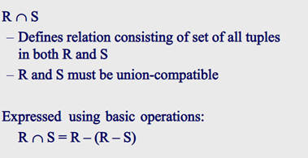
Intersection
(r – s) gives tuples that are in r but not in s.
If we take those tuples away from r, we are left with only tuples that are in r and in s.
It is easier just to use ∩.

Slide 40
Example- Intersection
Write an expression which will find students are taking the course ICT252 and ICT231.

Slide 41
This can be viewed as the intersection of 2 sets or relations:
Π_{stud_id} (σ_{course_code=”ICT252”} (studentCourse))
∩
Π_{stud_id} (σ_{course_code=”ICT231”} (studentCourse))

Slide 42
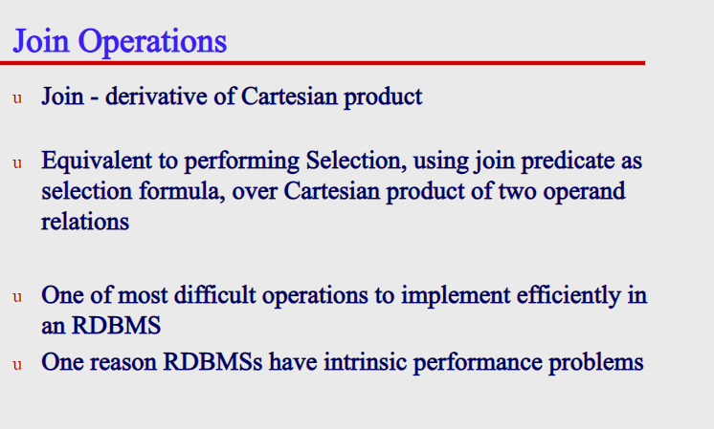

Slide 43
Join Operations
Various forms of join operations
Inner Joins: only those tuples that satisfy the matching criteria are included, while the rest are excluded.
Theta join
EQUI join(a particular theta join)
Natural join
Outer join: along with tuples that satisfy the matching criteria, we also include some or all tuples that do not match the criteria.
Left Outer Join
Right Outer Join
Full Outer Join
Semi join

Slide 44
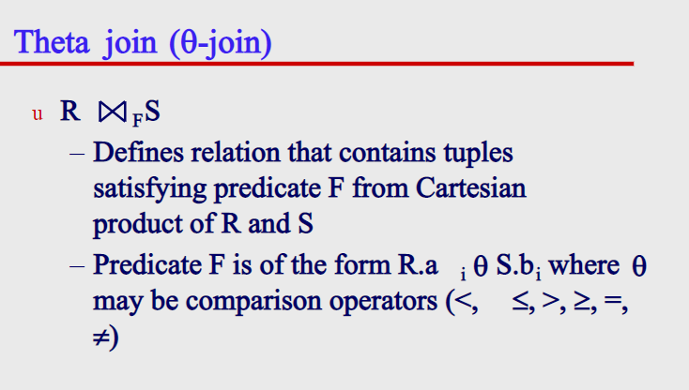

Slide 45
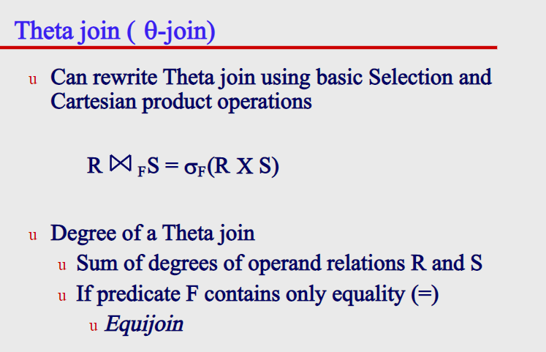

Slide 46
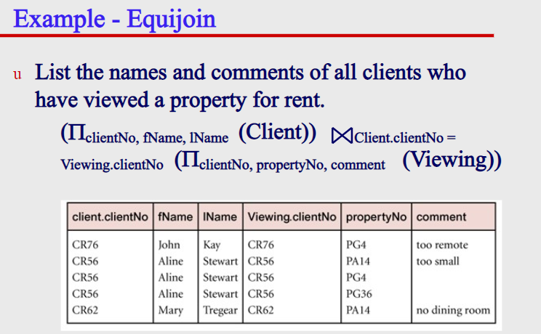

Slide 47
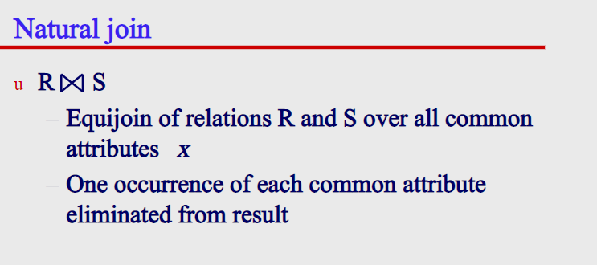

Slide 48
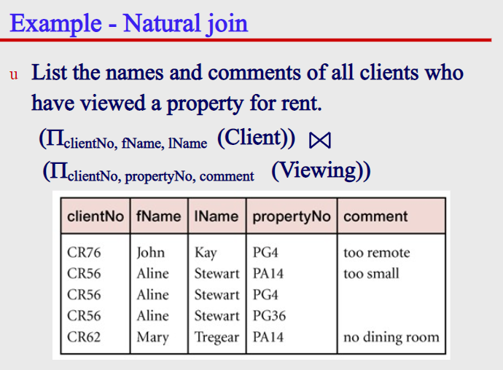

Slide 49
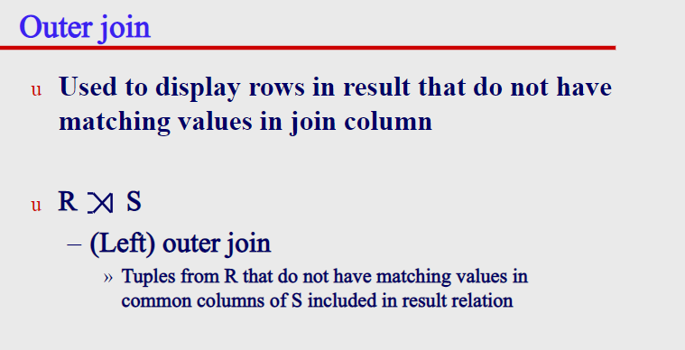

Slide 50
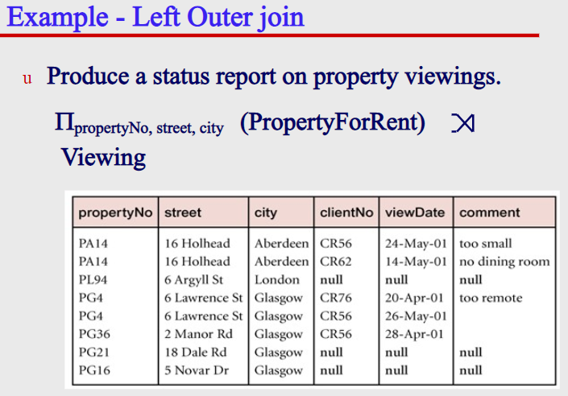

Slide 51
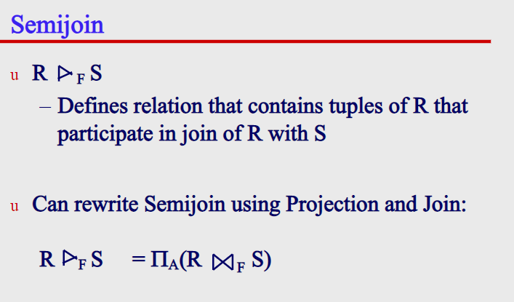

Slide 52
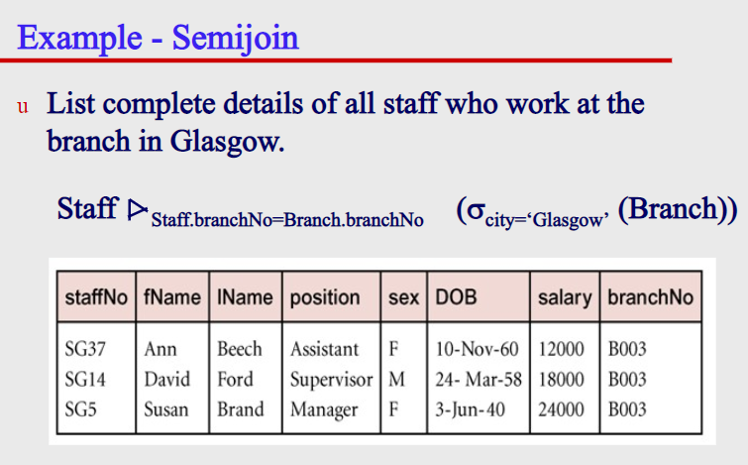

Slide 53
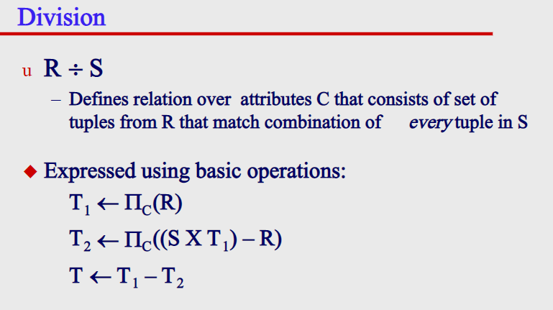

Slide 54
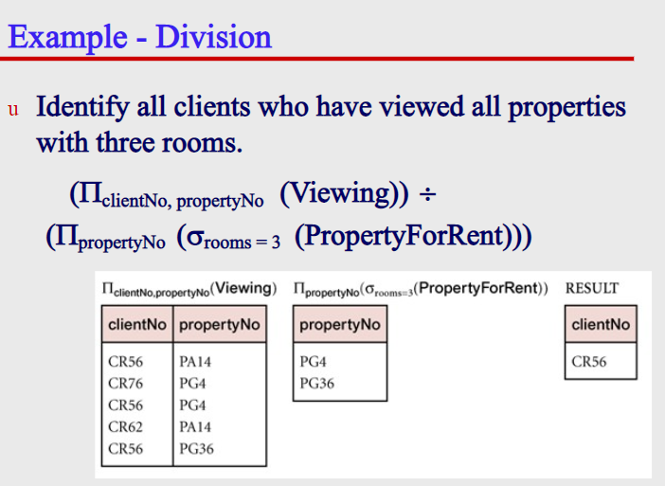

Slide 55
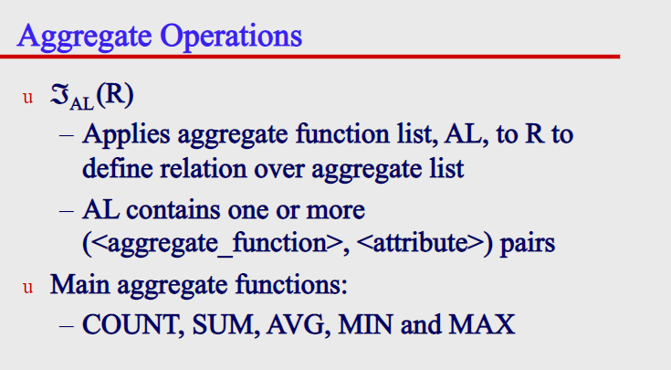

Slide 56
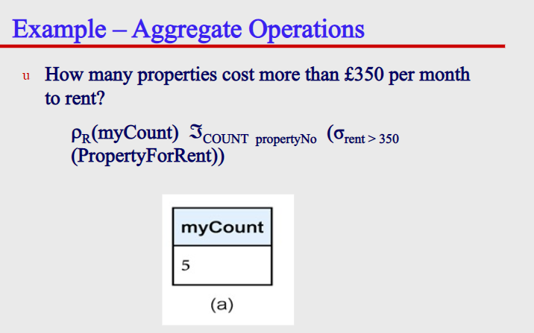

Slide 57
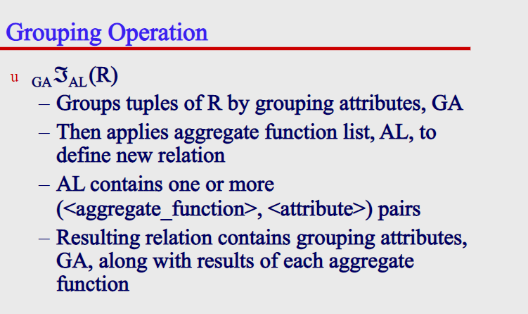

Slide 58
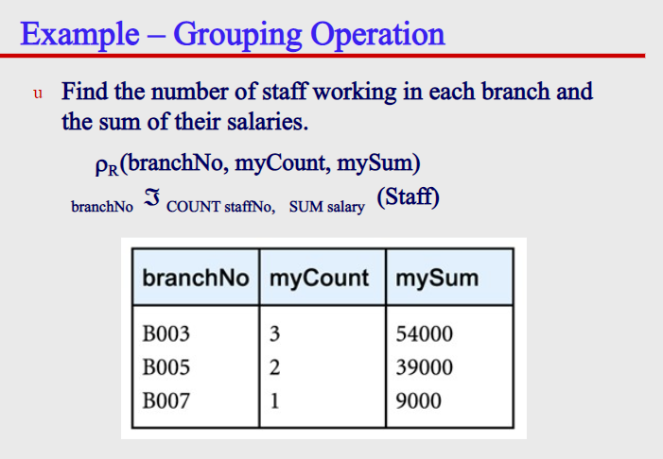

Slide 59
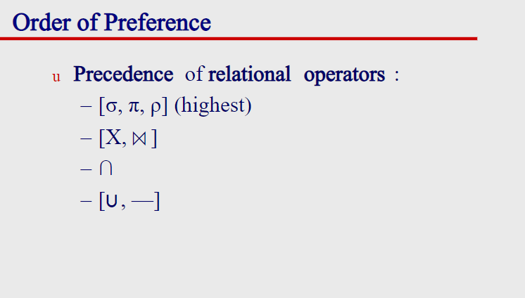

Slide 60
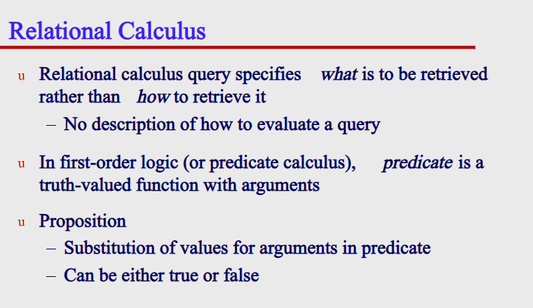

Slide 61
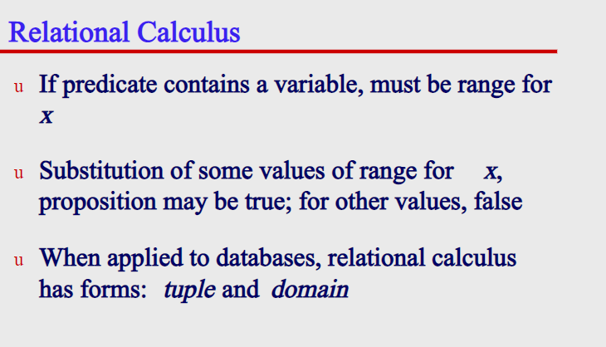

Slide 62
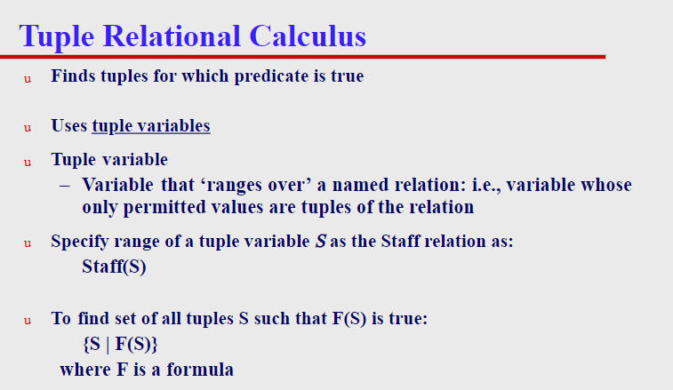

Slide 63
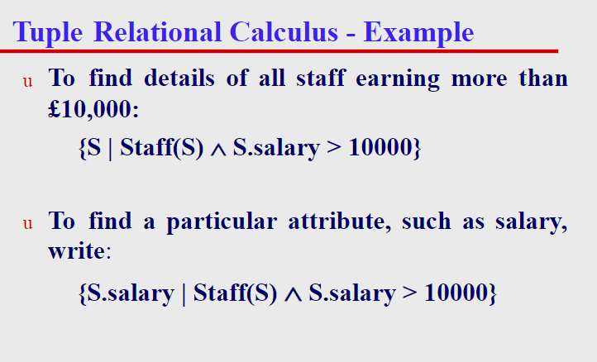

Slide 64
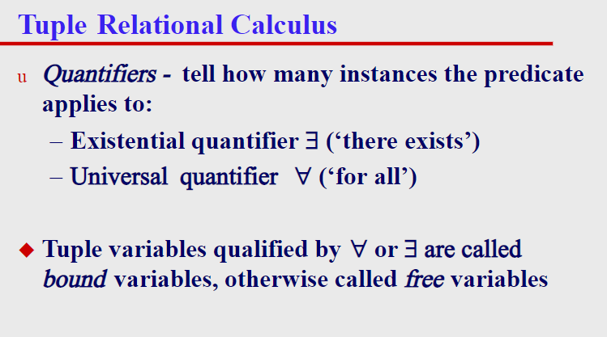

Slide 65
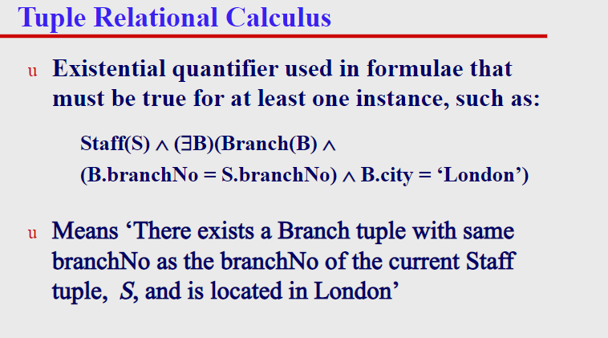

Slide 66
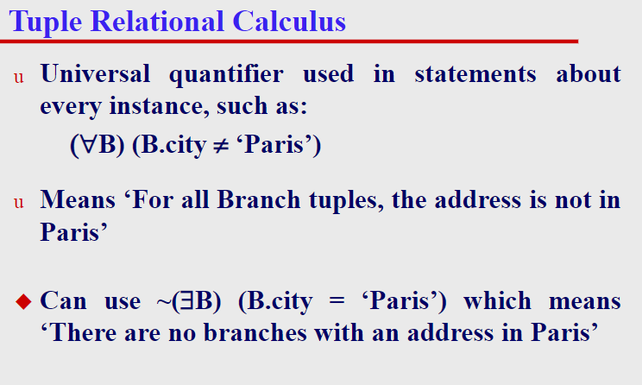

Slide 67
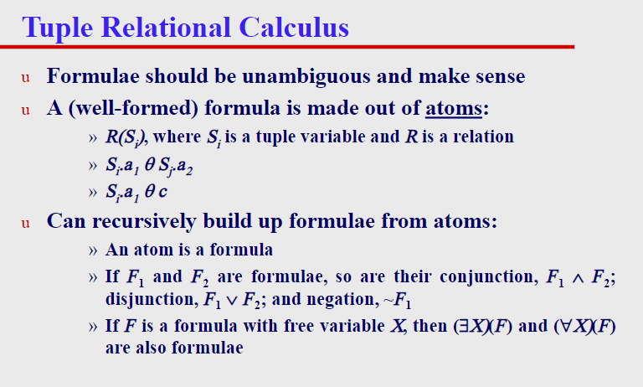

Slide 68
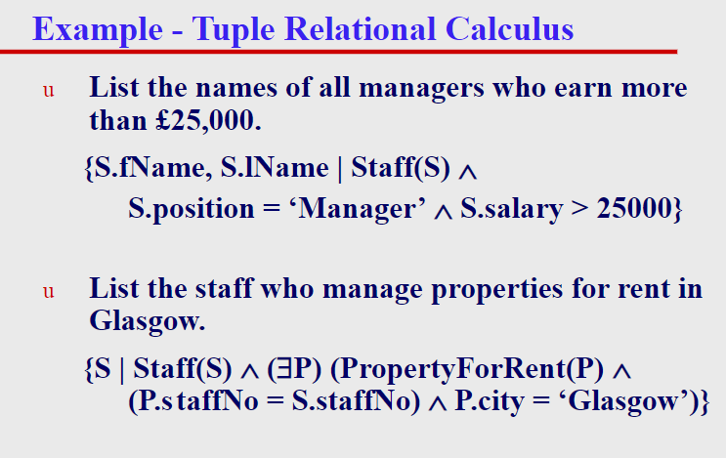

Slide 69
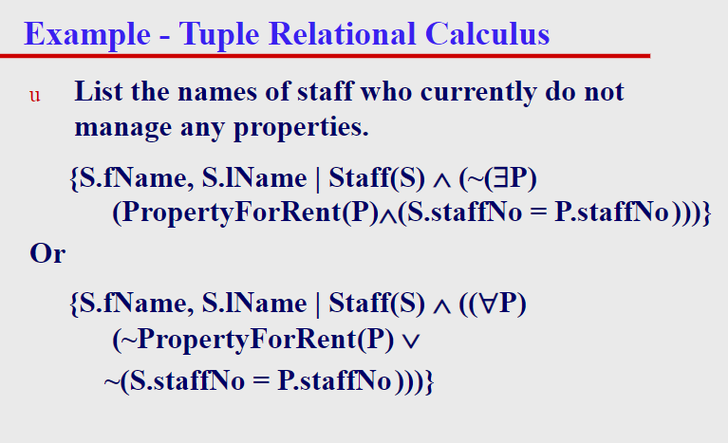

Slide 70
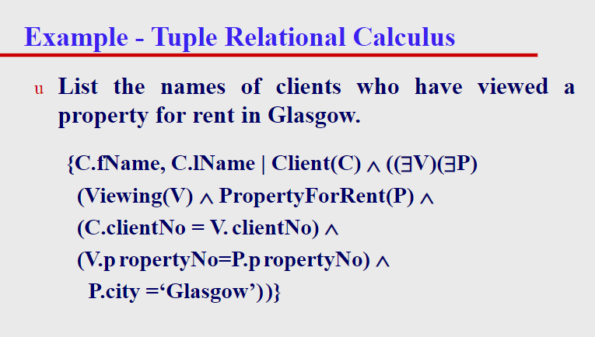

Slide 71
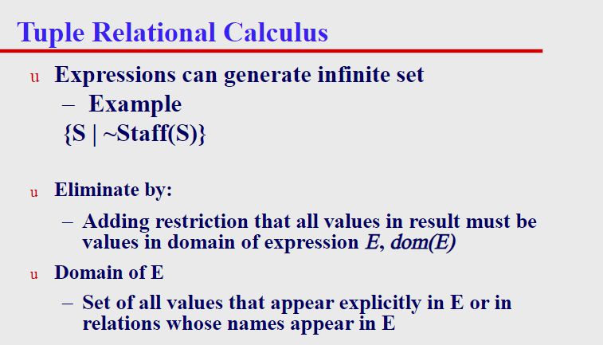

Slide 72
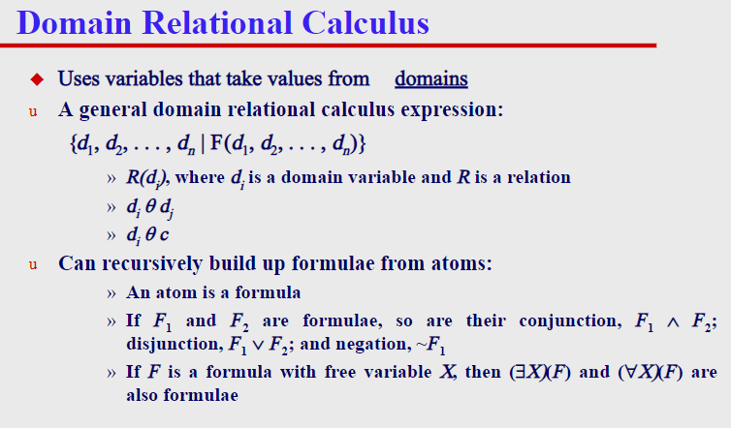

Slide 73
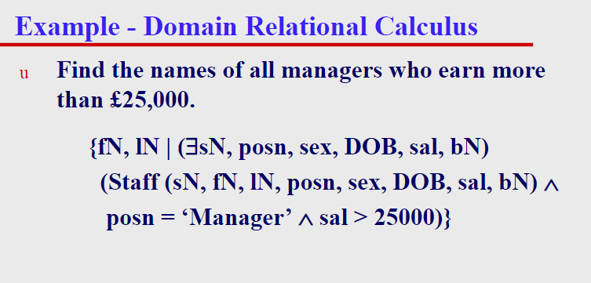

Slide 74
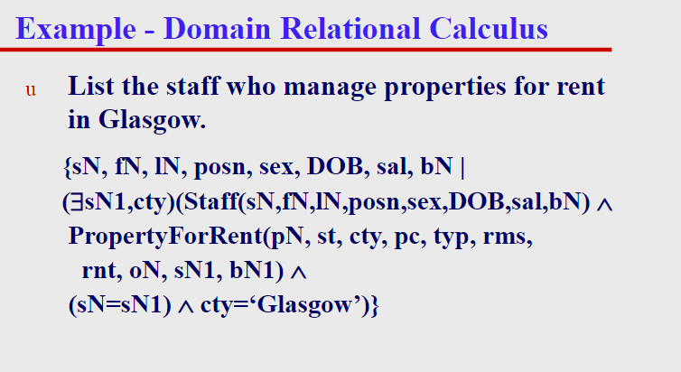

Slide 75
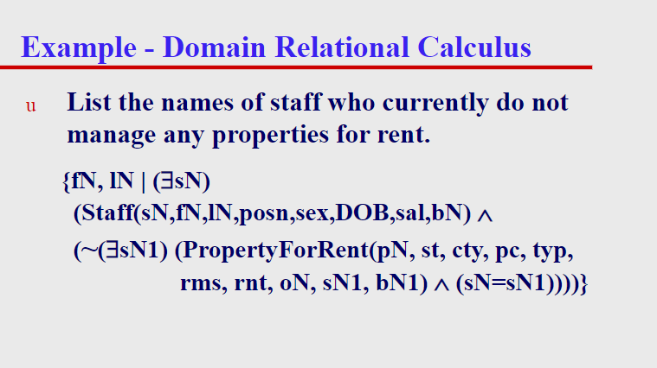

Slide 76
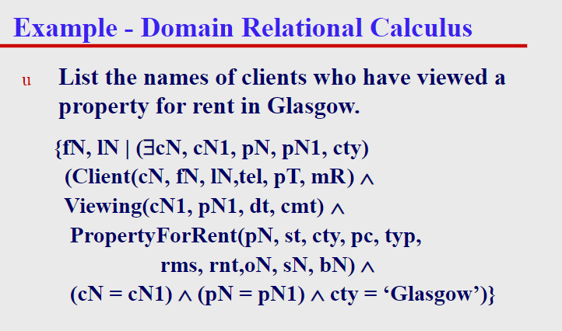

Slide 77


Slide 78


Slide 79


Slide 80


Slide 81


Slide 82


Slide 83


Slide 84


Slide 85


Slide 86


